Slide 1

Databricks World Cup 2024
Agile Genius - Agentic Framework
Photon Prophets:
Sridhar Pothamsetti
Manish Bhoge
Harsh Narayan
Vedavyasa Narayana
October 2024

Slide 2
Contents
01
Introduction
02
Problem Statement
03
Solution
04
Features
05
Architecture and Tech stack
06
Thank you

Slide 3

Introduction
01

Slide 4
What is Agile Genius – Agentic framework?
INTRODUCTION
Agile Genius – Agentic framework
The Agile Genius - Agentic Framework is a set of digital agents designed to take on key Agile roles:
Product Owner
Scrum Master
Project Manager
These agents work collaboratively to manage Agile processes, enabling human team members to focus on development and innovation while ensuring seamless sprint planning, resource management, and meeting facilitation.

Slide 5

Agile Genius – Agentic framework
Problem Statement
High Administrative Burden: Agile teams are often slowed down by the repetitive tasks of sprint management, meeting facilitation, and backlog prioritization, leaving less time for high-value work.
Inconsistent Agile Practices: With multiple Agile roles, achieving consistent practices across teams can be challenging, especially when team members have varying levels of experience with Agile.
Limited Real-Time Insights: Traditional Agile roles rely on manual updates and periodic reports, resulting in delayed visibility into team performance, project progress, and blockers.
Resource Management Bottlenecks: Manual resource allocation can lead to delays and imbalances in workload distribution, which disrupts sprint flow and impacts productivity.

Slide 6

Agile Genius – Agentic framework
Solution
Showcases the core functionalities of the Agile Genius - Agentic Framework, addressing the challenges of Agile team management with a suite of specialized agents.
Prioritization and Backlog Management
Product Owner AI: Converts business needs and feedback into actionable backlogs, dynamically prioritizing tasks and communicating updates to stakeholders.
Real-Time Resource Management
Dynamic Resource Allocation: Adjusts team resources based on workload, optimizing sprint flow and maintaining productivity with proactive task distribution.
Sprint Progress and Performance Tracking
Automated Status Reporting: Tracks sprint metrics in real-time—velocity, burndown rates, task completion—and provides insights through live dashboards and status reports.
Feedback-Driven Sprint Refinement
Continuous Improvement Loop: Gathers feedback and performance data post-sprint to fine-tune Agile practices, enhancing team adaptability and long-term success.

Slide 7



Query Processing
Agentic Chain Activation
Role-Based Response Generation
When a user submits a query, it initiates a collaborative response chain across the Agile agents. This query triggers the predefined prompts within each agent’s specific template, guiding their responses according to role-based objectives.
Product Owner, Scrum Master, and Project Manager agents each activate their prompt templates to address the query. They access Databricks serving endpoints for AI model support, enabling nuanced, role-specific interpretations of the query.
Each agent leverages vector similarity search using a designated vector database, efficiently retrieving relevant data, documentation, or prior Agile artifacts that align with the user’s input.
The Product Owner prioritizes the query based on backlog alignment, using similarity results to ensure responses reflect business objectives.
The Scrum Master synthesizes data for Agile ceremonies or meeting insights, refining the response to support team communication and alignment.
The Project Manager optimizes resource or timeline-related aspects, focusing on effective allocation and project deliverables.

Slide 8

Agile Genius – Agentic framework
Current State
User Interaction: The application accepts user queries.
Agentic Chain Initiation: Triggers the agentic chain involving the Product Owner, Scrum Master, and Project Manager.
Similarity Search: Executes similarity searches in the vector database.
Prompt Utilization: Leverages predefined prompts via serving endpoints.
Collaborative Response Generation: Agents generate context-aware responses:
Product Owner: Optimizes the product backlog.
Scrum Master: Facilitates Agile ceremonies.
Project Manager: Manages resource allocation.
Outcome: Enables AI-generated insights and enhances decision-making for Agile teams.

Slide 9

Future Plans
Agile Genius – Agentic framework
Refine Agent Collaboration: Enhance the interaction and collaboration between the Product Owner, Scrum Master, and Project/Resource Manager agents to improve decision-making and project outcomes.
Expand Query Capabilities: Integrate more diverse data sources and file formats, such as APIs and third-party services, to allow agents to gather and analyze a broader range of data relevant to project needs.
Enhance AI-Driven Recommendations: Develop advanced algorithms for the agents to provide smarter, data-driven recommendations on backlog prioritization, resource allocation, and meeting facilitation based on historical project data and user inputs.
Continuous Learning Mechanism: Implement a feedback system where agents learn from user interactions and outcomes to improve their responses over time.

Slide 10
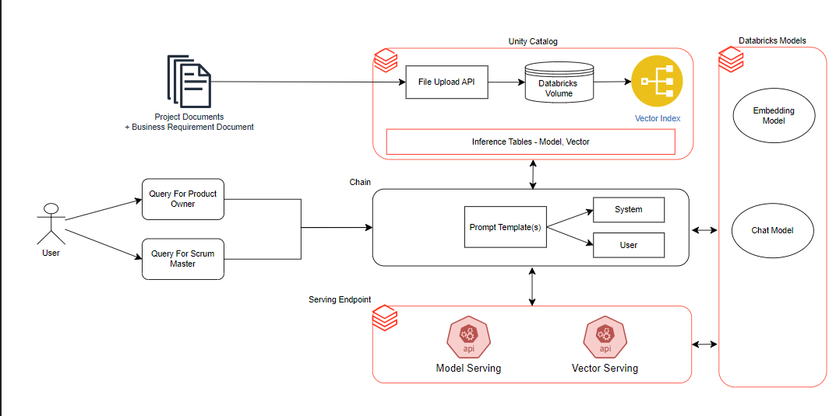
Agile Genius – Agentic framework
Agentic Agile Framework Architecture

Slide 11

Tech Stack
Agentic Agile Framework
Programming Language: Python
IDE : Databricks Web Terminal
User Interface (UI): Gradio
Model serving:
Chat Model :
DBRX (Databricks)
Embedding model:
databricks-gte-large-en
Vector Serving:
Vector Search Index
Database: Delta Lake

Slide 12

Thank you!

